Slide 1
Agile Development
Topic 7:
Project Management (Part 2 – Quality and Testing)
Notes:
NCC Education - Title Master

Slide 2
Topic 7 Coverage
This topic will cover:
  Quality and Configuration Management;
  Testing;
Notes:
You should note that Configuration Management is covered with quality because there is a strong link between the two: without version control and good management of the developing solution (configuration items) the quality of the end solution cannot be protected.

Slide 3
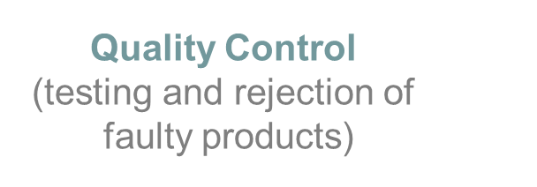
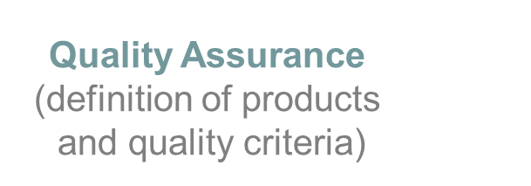


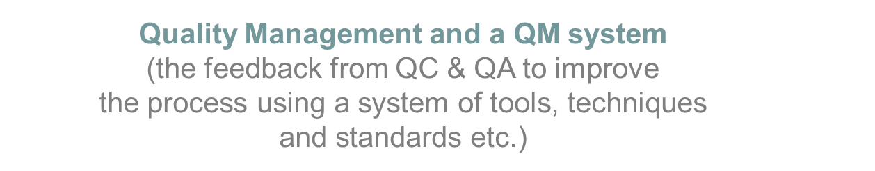
What is Quality?
“Fitness for Purpose”
Solution
Quality
Process Quality
Notes:
The industry best-practice definition of quality is “fitness for purpose”. DSDM considers both the quality of the solution and the quality of the process for arriving at the solution. Agile teams not only work to produce an appropriate quality solution but, through ”retrospectives” at the end of each timebox, and constant refining of their ways of working, strive to improve those working practices.

Slide 4
Quality Assurance in DSDM
DSDM Quality Audit focuses on these key areas:
  Is business involvement sufficient?
  Is team really empowered?
  Is life-cycle being followed?
  Are products being produced?
  Is feedback from reviews being incorporated?
  Is backtracking possible?
  Are priorities being adhered to?
  Are timeboxes being respected?
Notes:
To ensure effective quality audits are conducted these are the key areas where quality may suffer if they are not all managed correctly, and in conjunction.

Slide 5
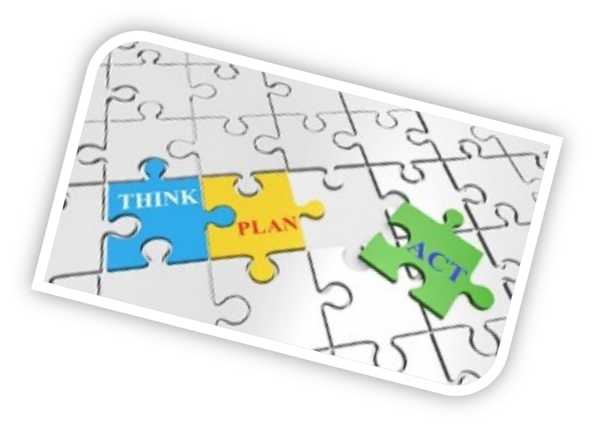
Quality Management Steps
Say what you are going to do.
Do it.
Demonstrate that you have done it.
Source: Image from pixabay.com © 2016
Notes:
The International Standards Organisation (ISO) has defined standards for quality in software-related projects. ISO 9001 and other standards in this numerical sequence (ISO 9000) apply. These can be expressed simply as in the slide: “Say what you are going to do, do it, demonstrate that you have done it.” Thus, for each timebox within the project we should set our expectations at the outset and test against those at the timebox end.

Slide 6
Quality Related Activities
  Points to consider are:
    Inspection and review against product descriptions
    Dynamic testing
    Static testing
    Review/demonstration of key prototypes
Notes:
Quality checking activities (Testing) can take a variety of forms, as listed here.

Slide 7

Maintainability versus Cost
Senior Management decision at outset:
    Maintainability a requirement for the new system, or
    Maintainability is not a problem: short system life, replaced before maintenance an issue, or
    Maintainability secondary to rapid delivery.
    The business will accept cost of re-engineering
Source: Image from pixabay.com © 2016
Notes:
DSDM Version 4.1
Project Management Considerations
Maintainability is an aspect of the quality of a solution. Agile is often seen as a “quick and dirty” approach, producing poor quality or unmaintainable solutions. DSDM has been specifically developed to protect quality, including an “up-front” decision about the maintainability of the solution to be developed.

Slide 8
Group Exercise: Maintainability Decision
In groups, decide which of the 3 maintainability options applies for the case study project.
Notes:
DSDM Version 4.1
Project Management Considerations
Class Exercise: Maintainability
This is intended as an informal exercise for discussion within the class. The probable answer is that a system will be produced for re-engineering later. This is because time is very short and something must be done to limit damage to the business. However, you can bring in the need for management to commit to a budget being available beyond the 3 month timeframe for these later improvements.

Slide 9



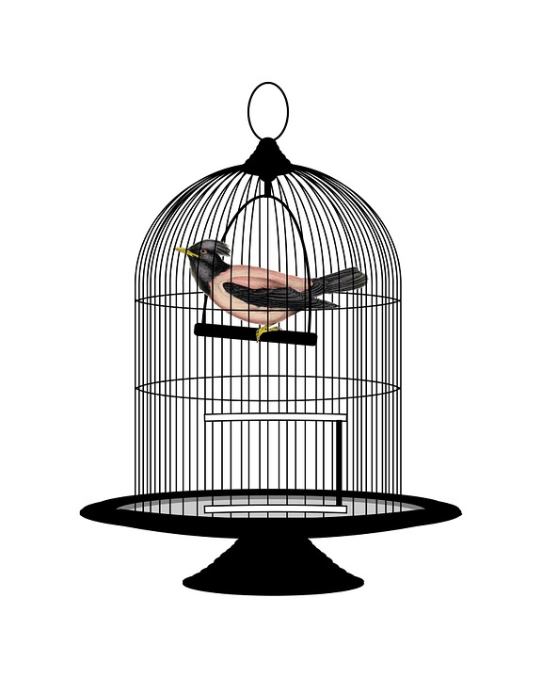


What is Configuration Management - 1?
Source: Images from pixabay.com © 2016
Notes:
Configuration management is a protector of the quality of the emerging solution, controlling the elements of the solution as it is developed. Configuration management is about:
Planning
Identification of configuration items
Control of change
Status accounting - reporting
Verification - that the status of items in the records matches their actual status
The pictures on the slide show:
The key Cows - Configuration items are identified uniquely (cows are identified individually by ear-tags)
A judge’s hammer, or ‘gavel’ - A prisoner is having his “status” set! Status of Configuration items needs to be agreed: e.g. draft, approved, implemented.
A Jail - This is to indicate the protection and control of pieces of work (configuration items) once they have been placed under control (restriction of access to them)
Builder: the product is evolving and needs control of status during this evolution
A bird in a cage - we need to prevent value being lost by developed parts of the solution “escaping” or being lost.
Barbed-wire fence: This shows the need to have configuration management to protect the emerging products of the project.
Agile point is that configuration management must not restrict the constant evolution of the solution. However, an appropriate level of control is needed. The DSDM Handbook has a chapter of guidance on configuration management. This is more in-depth than needed for this topic, but may provide you with useful background reading, if required.

Slide 10
What is Configuration Management - 2?
  Configuration management is the process of:
  Identifying and defining configuration items (CIs) of a system;
  Controlling release and change of CIs throughout the lifecycle;
  Recording and reporting status of CIs and change requests;
  Verifying completeness and correctness of Cis;
Notes:
This slide shows a definition of configuration management and change control.

Slide 11

What is Configuration Management - 3?
Change Control: the set of formal procedures which record and enable changes to configuration items.
Source: Image from pixabay.com © 2016

Slide 12

Configuration Management
Why is CM necessary?
  Iteration implies change, which must be managed
  Changes must be reversible - version control
  Solution developers need to be confident of right version
What is a CM Champion?
  Tech. Co-ordinator?
  Within team
Source: Image from pixabay.com © 2016
Notes:
Note that a champion for configuration management should be identified within the team, rather than this control being supplied from sources external to the team.

Slide 13

Configuration Management Strategy
Baselining: a snapshot at a point in time
Continual integration
Baseline prototypes:
  Before demonstration
  After approval
Baseline:
  Daily?
  After each item unit-tested?
  End of development timebox (at minimum)
Source: Image from pixabay.com © 2016
Notes:
You should define “baseline” and discuss the need for baselining, especially in a fluid, constantly-changing Agile environment.

Slide 14
Metrics in DSDM
Points to consider include:
  Immediate payback in an iterative environment;
  Why measure?
  Keep it simple, make it easy;
  What are we measuring?;
  Compare measures (need > 1!);
  Measures drive behaviour.
Notes:
DSDM Version 4.1
Project Management Considerations
The only way to monitor to improve is to capture metrics for the project. The Agile project should not be over-burdened with this, but does need some simple, easy-to-collect metrics for process improvement.

Slide 15

Group Exercise: Metrics
In groups, think of one simple (but imaginative!) metric which would measure the success of the case study project.
Source: Image from pixabay.com © 2016
Notes:
DSDM Version 4.1
Project Management Considerations
Class Exercise: Metrics
This is a short group-discussion exercise. There is no right answer, but any metric must be:
A good, direct measure of success of a specific aspect of the project, but should not be high in overhead to collect; and must be imaginative
It has been said within DSDM over the years that, at the end of the project, the size of the smiles on the users’ faces are the best metric!

Slide 16

Agile Testing Concepts
Collaborative
Repeatable
Prioritised
Risk-based
Independent
Test-driven
Fail fast
End-to-End Experience
Source: Image from pixabay.com © 2016
Notes:
The final part of the quality topic is testing - checking the quality.
Agile testing takes place throughout the lifecycle and has its own testing concepts, based on testing best practice. Specifically, Agile uses concepts such as “fail fast”; “collaborative” and “prioritised”. The key is that the members/teams work collaboratively to ensure effective testing is carried out.

Slide 17
Group Exercise: Using the Key Techniques in Testing
In groups, describe how the below techniques
could help in testing in an Agile (DSDM) project:
  Modelling
  MoSCoW Prioritisation
  Facilitated Workshops
Notes:
DSDM Version 4.1
Project Management Considerations
Class Exercise: Using the Key Techniques in Testing
The students should spend approximately 30 minutes assembling their points for each technique. You can then allow each group to describe the effect on testing and how the techniques could help in testing in an Agile project.
The discussion points in the answer would include:
Modelling
Can be used to structure tests
Process models can be used to ensure coverage of the tests by showing, simply, all of the processes
Moscow Prioritisation
Tests can be prioritised – it will seldom be possible to run all possible tests
Facilitated workshops.
Team members and other relevant stakeholders can use workshops to plan testing, define test priorities, and collaboratively test.

Slide 18
Summary of Quality and Testing
  The topic has covered:
    Quality
      What is quality?
      Maintainability
      Configuration management
      Baselining
      Metrics
    Testing
Notes:
In this topic we have looked at what quality encompasses; we have considered what quality is, and the importance of maintainability. We have looked at configuration management and the importance of baselining. Metrics are used in Agile development to ensure that certain goals are met. This is key to a successful project outcome. We also looked at testing; testing has to be a well planned consistent point to be addressed throughout the project. Testing must be a collaborative approach, that involves all key stakeholders and reaches beyond conventional software testing into user led testing to ensure the product meets the true requirements of the user.

Slide 19
Topic 7 – Project Management (Part 2 – Quality and Testing)
Any Questions?
Notes:
NCC Education - End Slide Master

